Slide 1
OASIS INFOBYTE | DATA ANALYTICS INTERNSHIP
WINE QUALITY PREDICTION
EDA & MACHINE LEARNING MODELS

Slide 2
Project Objective
Analyze the physicochemical properties of red wine.
Identify patterns and relationships in the dataset.
Train and evaluate machine learning classification models.
Compare model performance to identify the best-performing model.

Slide 3
Dataset Overview
The project uses the Red Wine Quality dataset.
Dataset: Red Wine Quality
Data Type: Numerical physicochemical measurements
Features: Acidity, residual sugar, chlorides, density, pH, sulphates, and alcohol.
Target: Wine quality category
Categories: Low, Medium, and High
The dataset is used to explore relationships between wine properties and quality.

Slide 4
Project Workflow
Data Loading: Imported the wine quality dataset using Python.
Data Exploration: Checked the dataset structure, missing values, and duplicates.
Data Visualization: Created charts to understand distributions and correlations.
Feature Engineering: Grouped wine quality scores into three categories.
Data Splitting: Divided the data into training and testing sets.
Model Training: Trained three machine learning classification models.
Model Evaluation: Compared model performance using evaluation metrics.

Slide 5
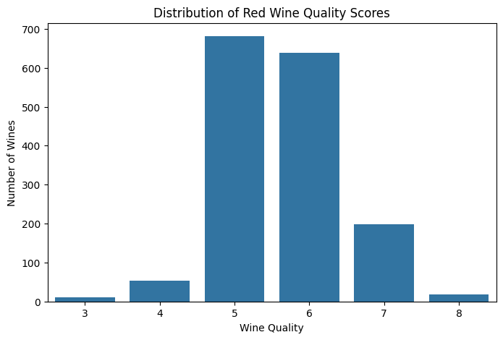
Exploratory Data Analysis (EDA)
Exploratory Data Analysis was performed to understand the dataset and identify patterns.
Checked the dataset structure and summary statistics.
Examined missing values and duplicate records.
Visualized the distribution of wine quality scores.
Created histograms to understand feature distributions.
Used a correlation heatmap to examine relationships between features.

Slide 6
Feature Engineering and Data Splitting
Quality Categories
Low Quality: Score ≤ 5
Medium Quality: Score = 6
High Quality: Score ≥ 7
Data Splitting
Training data: 80%
Testing data: 20%
Stratified splitting was used to maintain the distribution of quality categories.

Slide 7
Machine Learning Models
Three machine learning classification models were trained for wine quality prediction.
Random Forest Classifier
Uses multiple decision trees to make predictions.
2. SGD Classifier
Uses stochastic gradient descent to train a classification model.
3. Support Vector Classifier (SVC)
Classifies data by finding decision boundaries between categories.
The models were evaluated and compared to identify the best-performing model.

Slide 8
Model Evaluation and Comparison
The performance of the three classification models was evaluated using multiple metrics.
Accuracy: Measures the overall percentage of correct predictions.
Precision: Measures how many predicted categories were correct.
Recall: Measures how many actual cases were correctly identified.
F1-score: Balances precision and recall.
Confusion Matrix: Shows correct and incorrect predictions for each category.
Model Comparison:
The Random Forest, SGD, and SVC models were compared using their evaluation scores to identify the best-performing model.

Slide 9
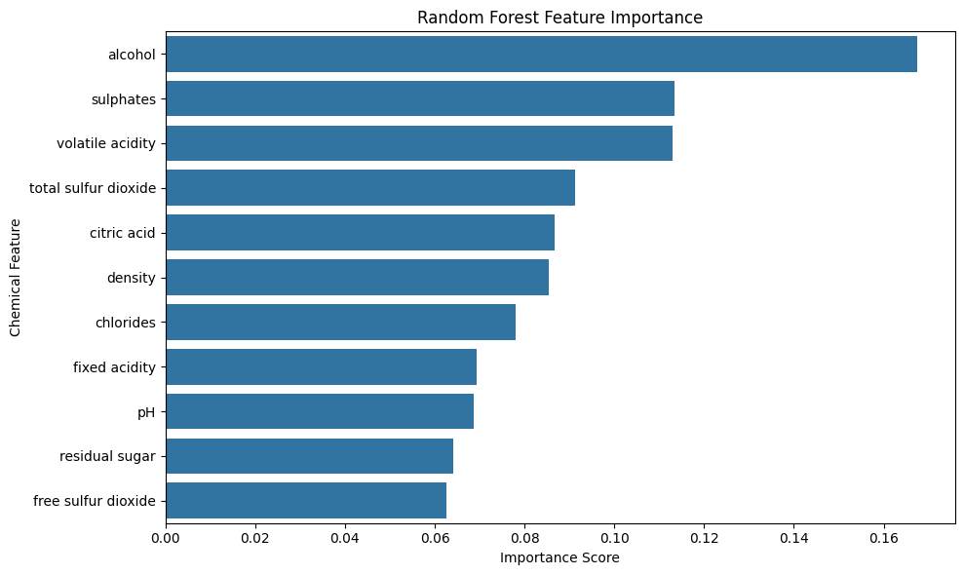
Feature Importance
Feature importance analysis was performed using the Random Forest Classifier.
Identified the chemical properties that contributed most to the model's predictions.
Compared the relative importance of different input features.
Helped understand which features influenced wine quality classification.
The analysis provides insights into the relationship between wine characteristics and predicted quality categories.

Slide 10
Conclusion
In this project, the task was to develop predictive models for the category of red wine quality using data analytics and machine learning.
Conducted exploratory data analysis on the dataset.
Categorized wine quality into Low, Medium, and High.
Developed three machine learning models: Random Forest, SGD, and SVC.
Compared model performances using several evaluation metrics.
Performed feature importance analysis to identify important chemicals.
Result: This project illustrated an application of machine learning to categorize wine quality.

Slide 11
Thank You!
Thank you for taking the time to view my project.
Wine Quality Prediction
Data Analytics Internship — Level 2, Task 2
Nandini Dolas

